Slide 1
Parkinson’s for Primary Care Doctors & Allied Health Professionals
Ray Dorsey, MD
University of Rochester

Slide 2
What is Parkinson’s?

Slide 3
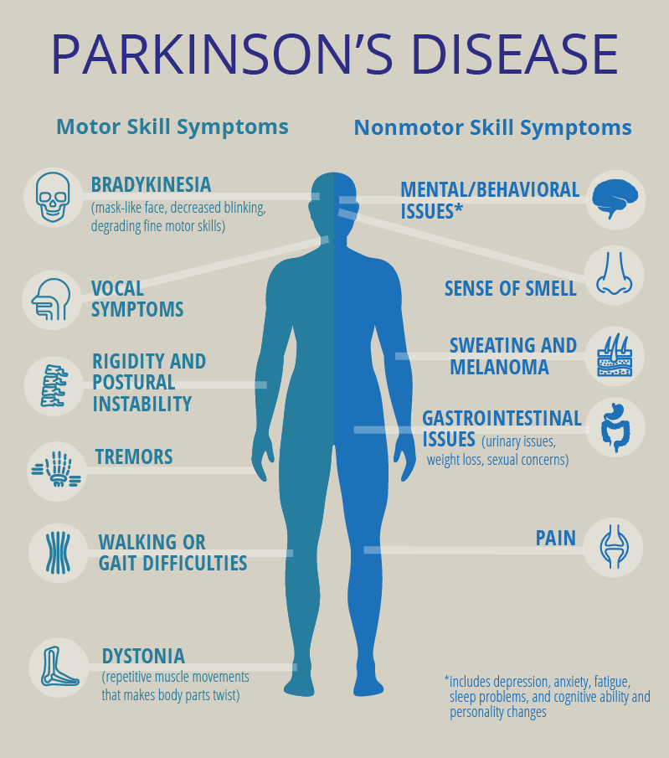
Parkinson’s is a debilitating disorder
Symptoms
  Tremor (mainly at rest and described as pill rolling tremor), slowness of movement, rigidity, gait, and balance problems
Cause
  About 10% have an underlying genetic cause; environmental factors likely predominate and lead to loss of cells in the brain that produce dopamine
Treatment
  Exercise, medication, and surgery for some
Sources: Neurology 2003; 60:1756-1761; JAGS 2000; 48(8):938-942; Mayo Clinic Proc 2002; 77:918-925; BMJ 1991; 303:741-743; Parkinsonism Rel Disord 2002; 8:369-380; JAGS 1996; 44(4):394-399

Slide 4
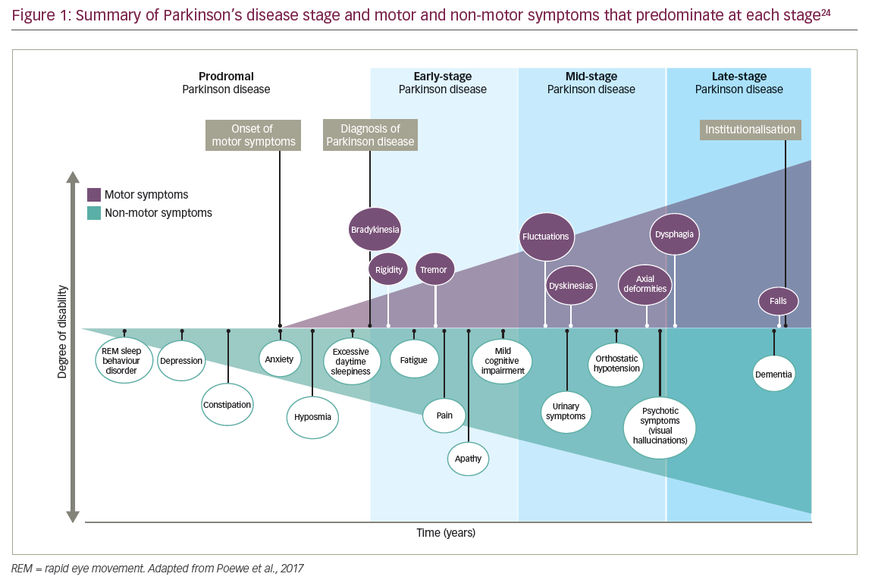
Symptom Burden in Parkinson
Takeaway: Non-motor symptoms are common, start before motor symptoms and accumulate with disease progression

Slide 5
Parkinson’s is now the fastest growing brain disease in the world
10 million
5 million
1990
2015
2040
Source: Dorsey ER, Bloem BR. The Parkinson Pandemic—A Call to Action. JAMA Neurol. 2018;75(1):9–10. doi:10.1001/jamaneurol.2017.3299

Slide 6






Environmental factors could explain the predominance of Parkinson’s among men
Percentage of U.S. workers who are men by occupation, 2016
75%
Farmer
80%
Metal and plastic laborer
90%
Chemical Worker
91%
Painter
96%
Welder
97%
Pest control
worker

Slide 7
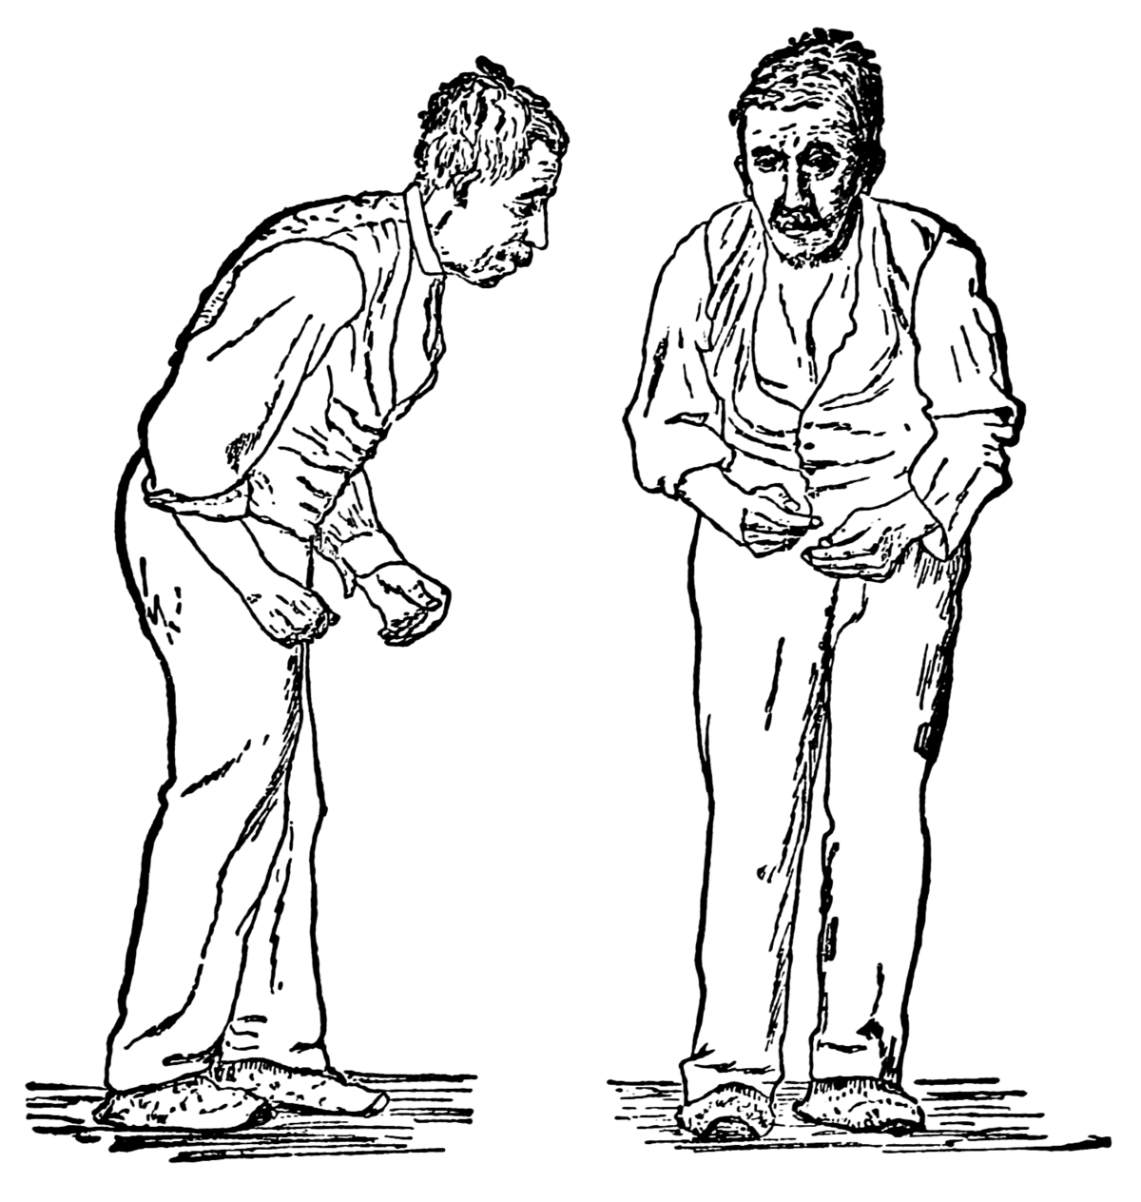
Other conditions can mimic Parkinson’s
Essential tremor
Normal pressure hydrocephalus
Dementia with Lewy Bodies
Multiple system atrophy
Corticobasal syndrome
Progressive supranuclear palsy
Sources: Parkinson’s Foundation. Conditions That Mimic Parkinson’s. Accessed 22 June 2020.; Image from https://en.wikipedia.org/wiki/Signs_and_symptoms_of_Parkinson%27s_disease

Slide 8
Caring for Parkinson’s

Slide 9
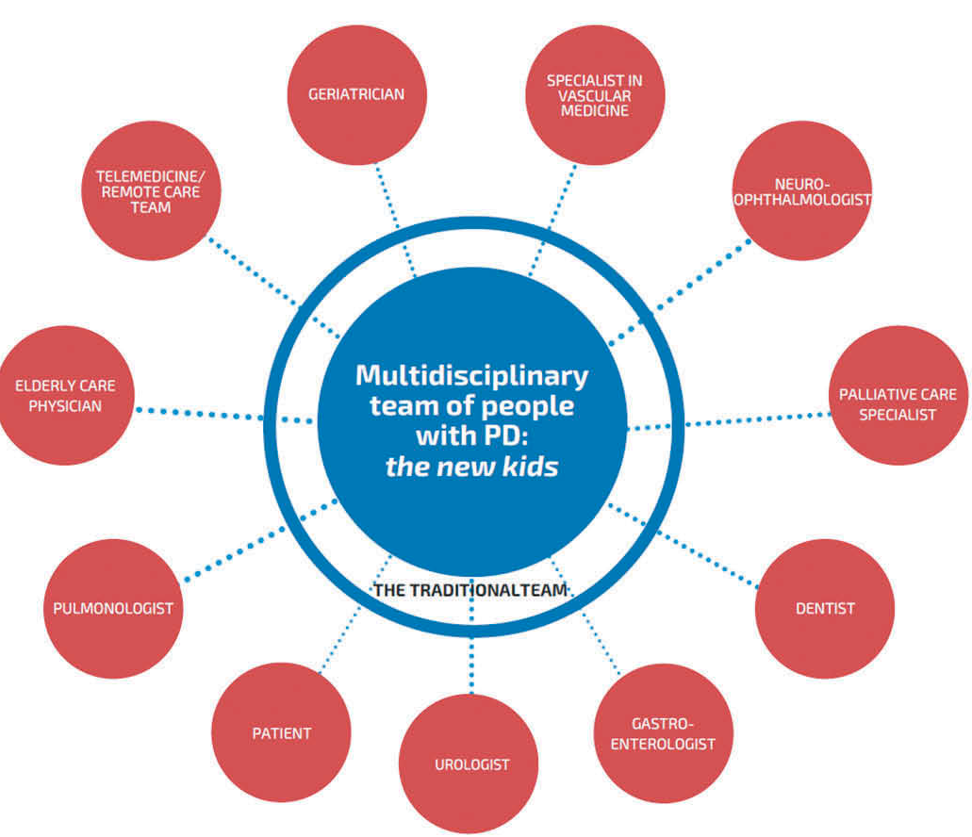
Parkinson's care benefits from a multidisciplinary team
Takeaway: Patients with degenerative chronic diseases like Parkinson’s require specialty medical care, nursing, and a range of supportive services
Source: Danique L. M. Radder, Nienke M. de Vries, Niels P. Riksen, Sarah J. Diamond, Ditza Gross, Daniel R. Gold, John Heesakkers, Emily Henderson, Adrianus L. A. J. Hommel, Herma H. Lennaerts, Jane Busch, Ray E. Dorsey, John Andrejack & Bastiaan R. Bloem (2018): Multidisciplinary care for people with Parkinson’s disease: the new kids on the block!, Expert Review of Neurotherapeutics, DOI: 10.1080/14737175.2019.1561285

Slide 10




Exercise can help maintain physical fitness and health
Recommendations for exercise in Parkinson's
Aerobic
20-60 min/day, 3-5 days/week
Balance
10-15 min,
2-3 times/week
Resistance
2-3 times/week
Flexibility
2-3 times/week
Source: Oliveira de Carvalho A, Filho ASS, Murillo-Rodriguez E, Rocha NB, Carta MG, Machado S. Physical Exercise For Parkinson's Disease: Clinical And Experimental Evidence. Clin Pract Epidemiol Ment Health. 2018;14:89-98. Published 2018 Mar 30. doi:10.2174/1745017901814010089

Slide 11
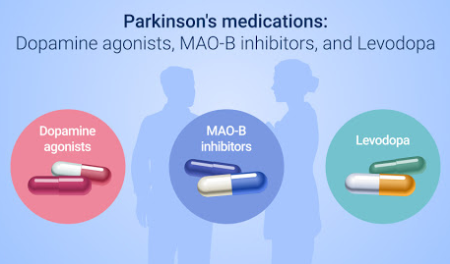
Current treatment options have limitations
Slowing disease
Motor fluctuations and dyskinesia
Freezing
Dementia
Neuropsychiatric issues
Sleep disorders
Autonomic dysfunction
Source: You and Parkinson’s. Treatment and Management of Parkinson’s Disease. http://www.youandparkinsons.com/en-pk/view/m301-s03-treatment-and-management-of-parkinsons-disease-slide-show

Slide 12
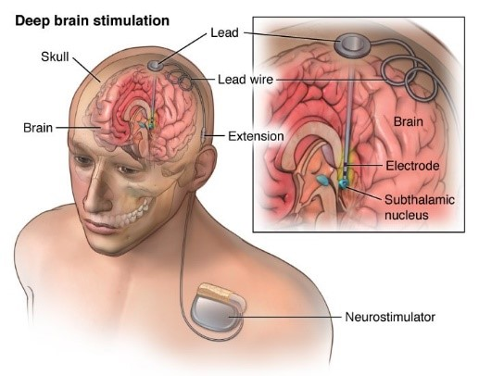
Deep brain stimulation (DBS)
Takeaway: For many patients, the response to DBS will be similar to levodopa but without the symptom fluctuations
Source: American Association of Neurological Surgeons. (2020). Deep Brain Stimulation. Retrieved from https://www.aans.org/en/Patients/Neurosurgical-Conditions-and-Treatments/Deep-Brain-Stimulation.

Slide 13
The future of telemedicine

Slide 14



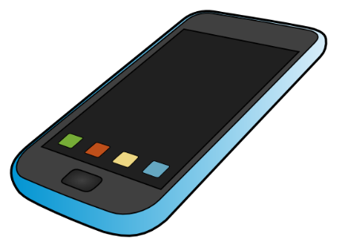
Telemedicine is increasing, moving care away from institutions
Banking analogy
Bank teller
ATM
Banking at home
Mobile banking

Slide 15
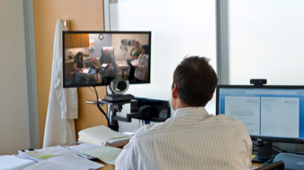
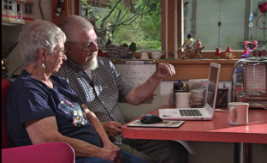
Telemedicine allows us to reach anyone, anywhere
Doctors deliver care from their office
Patients see doctor from their home

Slide 16

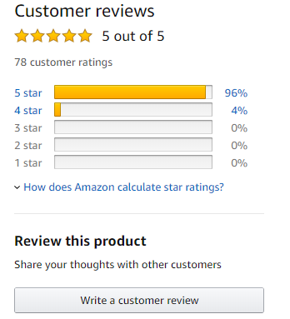


BUY
READ
REVIEW
endingPD.org
available at
All the authors’ proceeds are supporting efforts to end Parkinson’s
Questions? Comments? info@endingpd.org

Slide 17
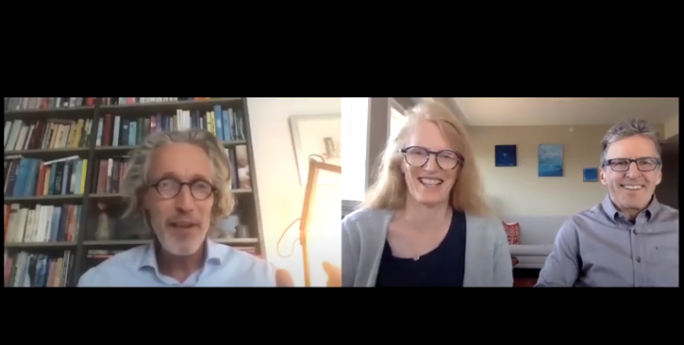
Ending Parkinson’s Disease Webcasts
Watch Dr. Bas Bloem’s talk with Davis Phinney and Connie Carpenter Phinney at endingpd.org/live

Slide 18
A PACT to end Parkinson’s
P | revent | Ban paraquat and trichloroethylene Test your indoor air and private wells Exercise, eat well, and enjoy your coffee
A | dvocate | Push for greater funding Support research efforts Share your story
C | are | Receive the care you want Expand telemedicine reimbursement Learn more about Parkinson’s
T | reat | Join a clinical study Know your ancestry Participate in research from your home

