Slide 1
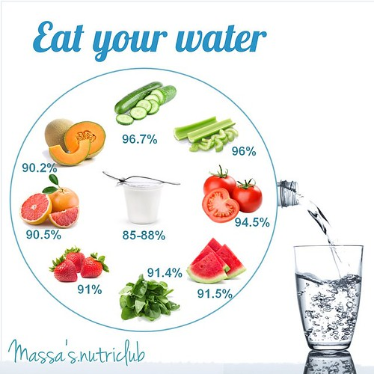
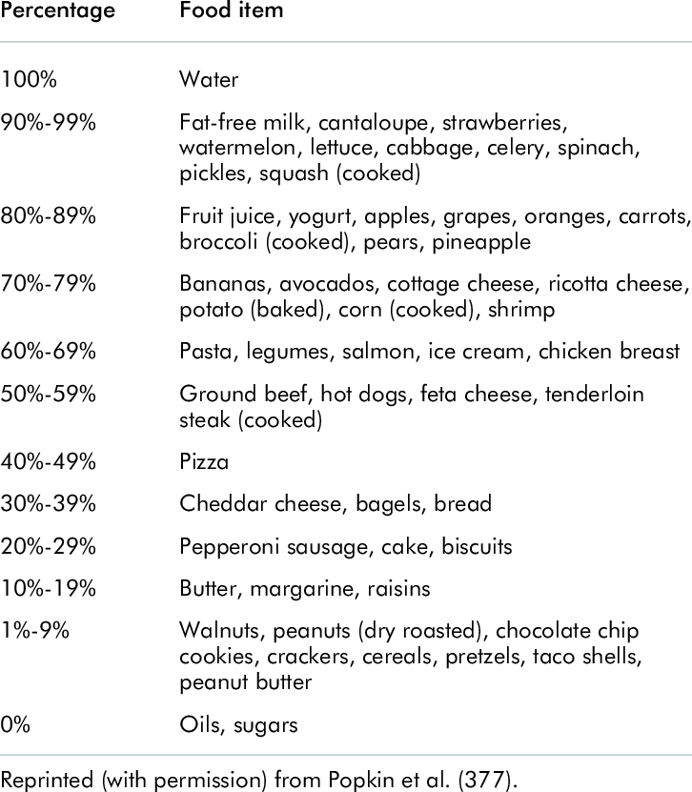
Notes:
The Water Content Range for Selected Foods | Download Table (researchgate.net)

