Slide 1
The Victory Summit®

Slide 2
Exercise & Parkinson's
Hannah Fugle, PT, DPT
St. Charles Health System
Bend, OR
Notes:
Hello,
I want to say WELCOME as well.
My name is Hannah Fugle and I am a doctor of physical therapy working in Bend, OR.
My clinical area of focus is neurologic care and my clinical passion is working with individuals who have neurodegenerative diseases.
Today we will be talking about the importance of exercise (or moving our bodies well).
Some of you may have just recently received your Parkinson's diagnosis while others have been living well with the disease for a number of
years. What I want to say is it is never too EARLY or too LATE to start exercising to combat the effects of Parkinson's!

Slide 3
Overview
Why Exercise?
How to Exercise
Action Steps YOU Can Take!
What is Dual Task?
Sticking With It
Notes:
I want to start with a quick overview of what we will be talking about today.
First we'll discuss why it is important to exercise, what are the benefits.
Then we will talk about how to exercise to optimize neuroplastic and neuroprotective changes we can receive.
I will then outline some actionable steps to empower you to start moving your body.
We will discuss the topic of dual task or split attention.
And then we will finish with some ideas for how to stick to and achieve your exercise goals.

Slide 4
Benefits of Exercise
Notes:
4

Slide 5
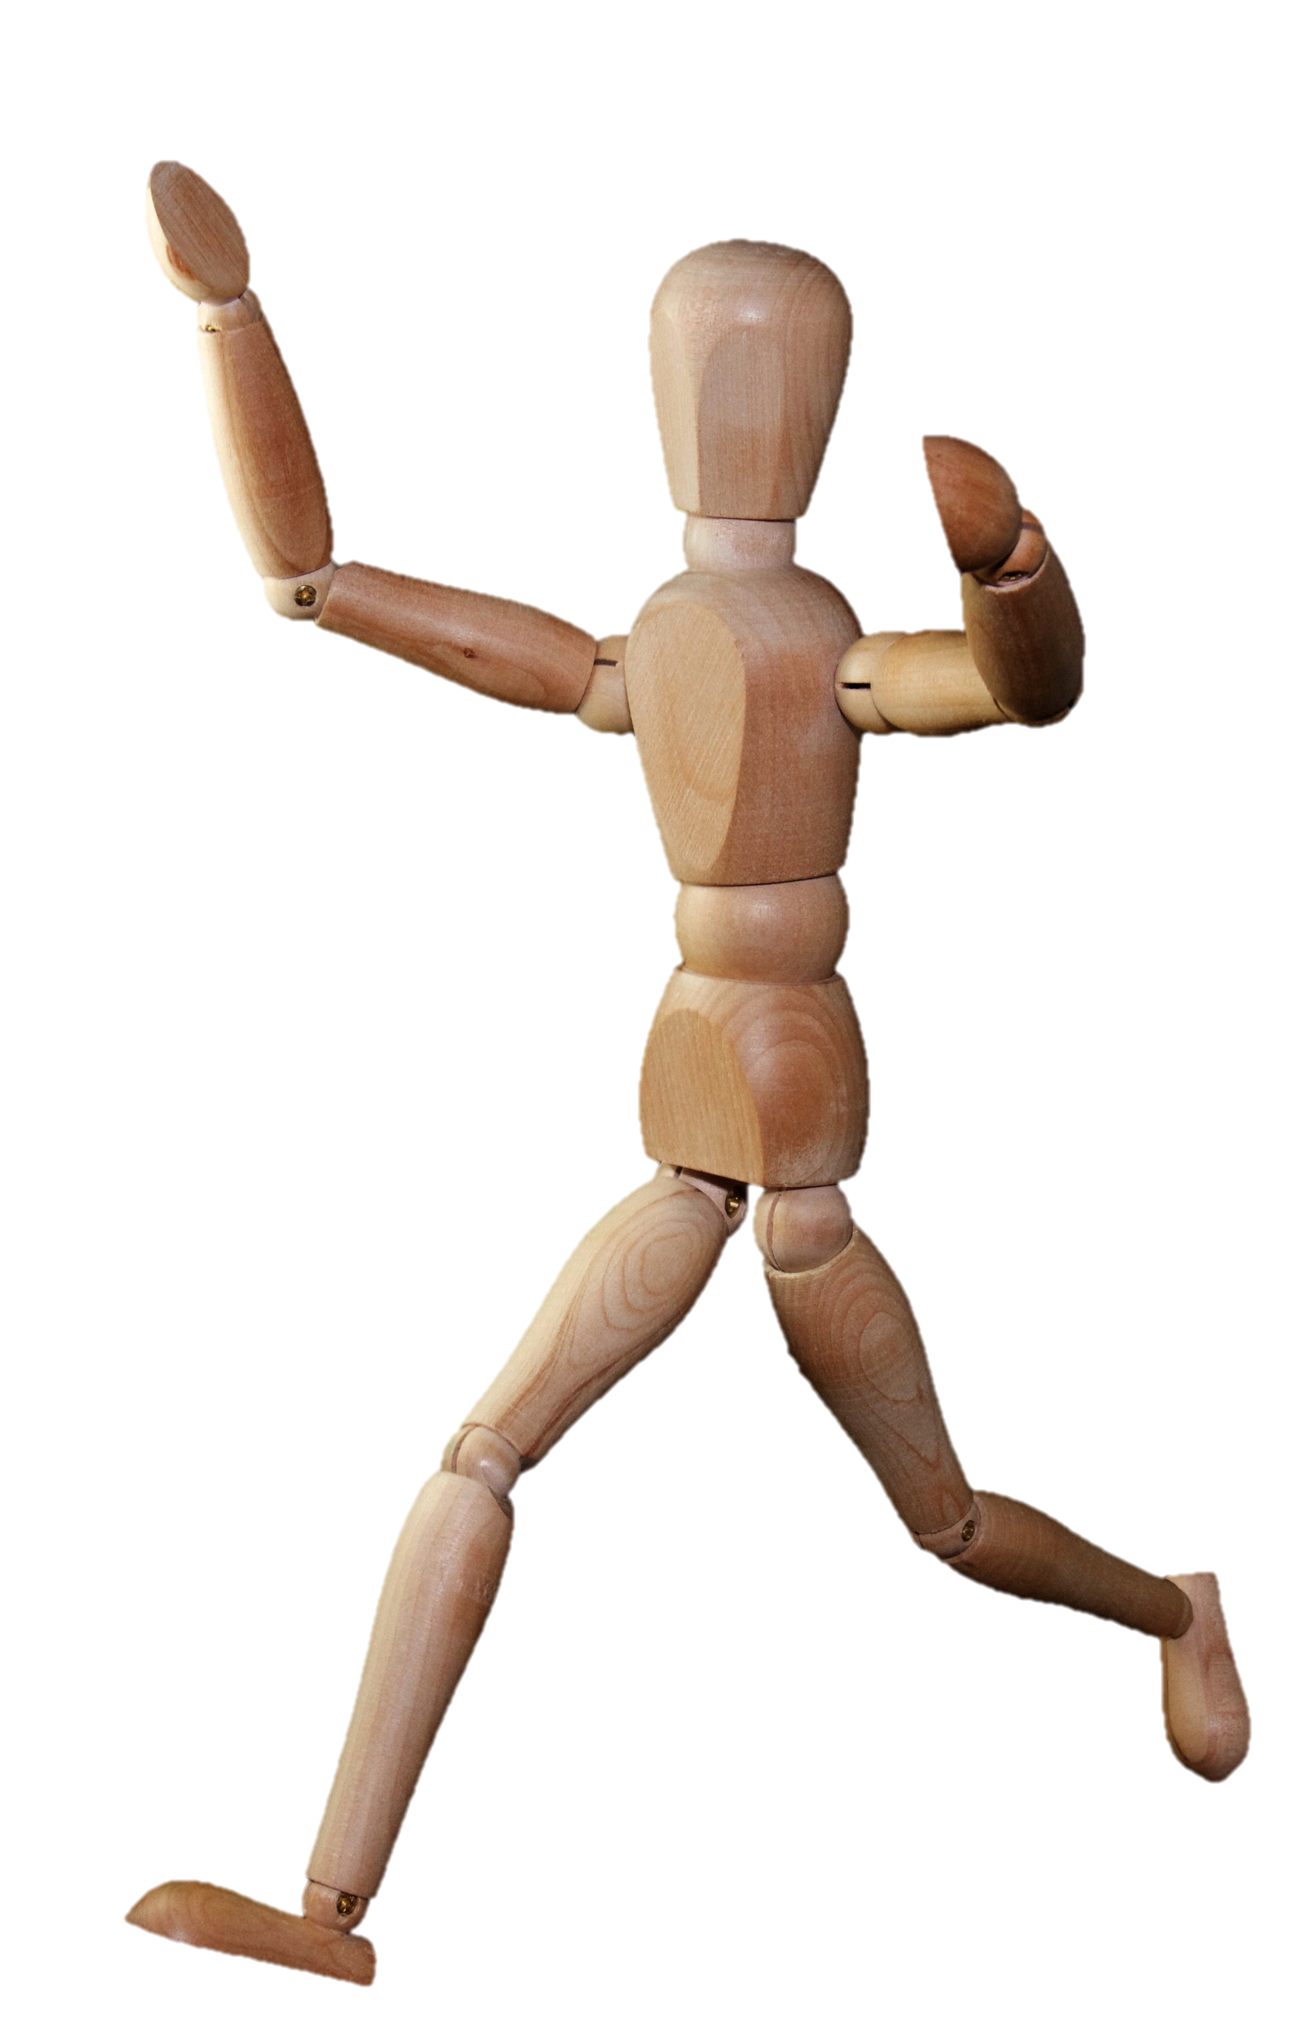
For Any BODY that Moves
Strength
Balance
Agility
Flexibility
Mood
Sleep
Gut Motility
Cardiovascular Health
Social interaction
Improved feelings of wellbeing and quality of life
Explore new hobbies and learn new skills
Notes:
For ANY body that moves we see improvements in strength, balance, and flexibility, as well as, improvement things like sleep and mood. Exercise can also
provide social interaction and the opportunity to try new things. Research has even shown it increases quality of life and your sense of wellbeing in the world. Who
doesn’t want those things??
https://pubmed.ncbi.nlm.nih.gov/27858719/: improved health quality of life and mobility (at 2 yr follow up)
5

Slide 6
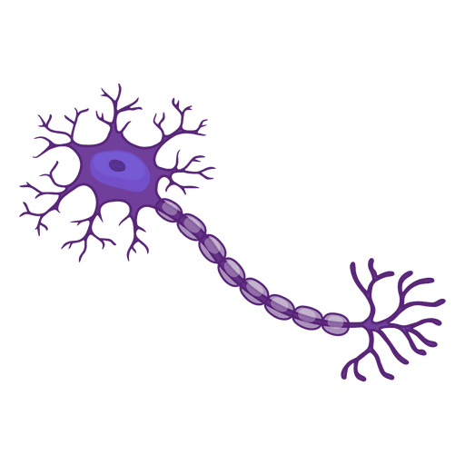
For People with Parkinson's
Improve effectiveness of medications.
Neuroprotective (slow degradation of brain tissue).
Promote more effective use of dopamine in the brain.
Combat motor breakdown.
Improve automatic nature of movement.
Notes:
But then what about for people with Parkinson's specifically?
What we know is that exercise helps improve the effectiveness of your medications, it promotes effcient use of dopamine in the brain, is neuroprotective (meaning it slows the rate of loss of dopamine producing cells in your substantia nigra), and it combats the breakdown of movement quality and automaticity that you need to move well in your day to day activities.
6

Slide 7
Promote Neuroplasticity!
Notes:
Lastly exericse has been shown to promote neuroplasticity!!
It has been found that by the time you are experiencing motor symptoms, most people have lost 80% of the dopamine neurons in the basal ganglia. We can't afford to lose any more! And we would like to gain back as much lost ground as possible by promoting brain changes and improve neuro circuitry connections.
https://www.sciencedirect.com/science/article/abs/pii/S1474442213701236: Neuroplastic synaptic and neuro circuity changes in response to exercise.

Slide 8
How to Exercise
To promote neuroplastic & neuroprotective change!
Notes:
So how do we exercise to promote these neuroplastic and neuroprotective changes??
There are a number of parameters that have been identified.
8

Slide 9
How To Exercise
High Intensity
Challenging and Cognitively Engaging
Repetitious
Progressive
Meaningful
Specific
Notes:
HIGH INTENSITY: We know that moderate intensity exercise maintains mobility, but HIGH INTENSITY (RPE 6-7) is needed to improve function, slow neuron degeneration, and improve efficiency of dopamine use. This could be achieved by frequency, effort level, force/resistance, or accuracy of task performance demanded. We will discuss this in future slides.
CHALLENGING & COGNITIVELY ENGAGING: We want the tasks you engage in to require your attention to perform them well.
REPETITIOUS: We need volume of exercise to see change.
PROGRESSIVE: We want the task to remain engaging of high enough intensity, so this means we need to progressive increase the demands of the exercise as you improve! We could do this by increasing weights, repetitions, speed, or duration. Remember, you are fighting your disease not those around you. Progress as your body is able, this timeline will vary for everyone.
SPECIFIC/MEANINGFUL: We want to choose activities that are meaningful and specific to you! This means we want it to matter and/or consist of movements and realistic environmental settings you encounter. For some people they may find meaning in going out for a bike ride with their family while others may find meaning and need specific training to get out of bed on their own. All these things matter!
** Also, I want to encourage you to exercise during medication "ON" times when your body is moving optimally. This is a question I often receive.
9

Slide 10
How To Exercise
High Intensity
Challenging and Cognitively Engaging
Repetitious
Progressive
Meaningful
Specific
ENJOYABLE!
Notes:
Lastly, choose what you enjoy!
You willl hear me say it several times throughout this talk but THIS IS A MARATHON, NOT A SPRINT. If you don't find a way to enjoy moving your body it will be much harder to stay with it.
10

Slide 11
Action Steps
Notes:
So now I'd like to dive into some action steps.
I want to equip you with some ideas, as well as, furthter flush out the concepts we just discuseed in the context of specific exercise examples.
11

Slide 12
Let's talk about...
Balance
Strength
Stretching & Posture
Aerobic Exercise
Dual Task Training
Notes:
During this portion we will talk about 4 main categories of movement and then touch on the concept of Dual Task Training that are vital for living well with Parkinson's disease.
12

Slide 13
Balance
GOAL: improve sensory information gathering and decrease reliance on vision.
Proprioception
Vision
Vestibular
Notes:
First, BALANCE!
Balance is really a of use it or lose it type of skill.
The goal praticing balance is to improve your body's ability to gather sensory information to keep you steady on your feet or bum. Balance really is just your body's ability to keep your body weight over your base of support. If your weight passes outside of this base then you feel off balance!
Our balance system is comprised of 3 main parts. PROPRIOCEPTION, or information coming from joints and muscles in your feet, legs, trunk, and neck that tell you internally where you are in space. VISION, which allows you to orient to the world around you. And the VESTIBULAR SYSTEM (or inner ear). This system provides information about the orientation and acceleration/deceleration of your head and therefore your body.
I have highlighted that to improve balance we often want to practice reducing the body's reliance on vision. This is because as we age or as the other systems become lazy we can become increasingly reliant on our eyes. If we allow this process to continue we are left with only 1/3 of the resources we have available to us!

Slide 14
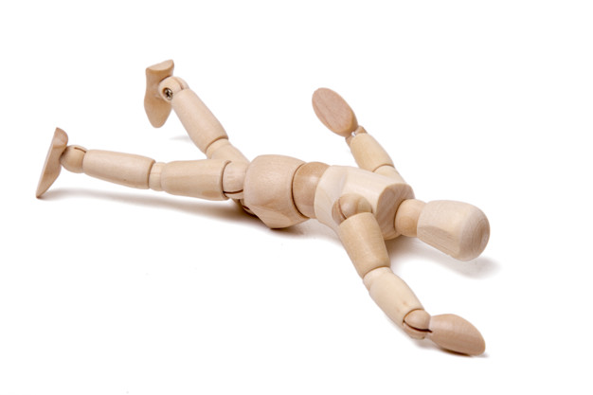
Balance
Reduce your risk for falls!
Notes:
The other reason it is important to engage in balance exercises is to reduce your risk for falls!

Slide 15
ACTION STEP:
Balance Practice
Notes:
So, let's practice!

Slide 16
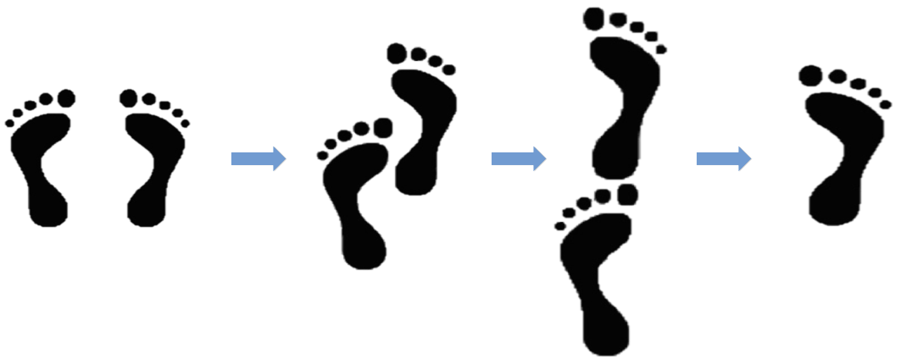
ACTION STEP: Balance Practice
Least Difficult Most Difficult
Notes:
What you see here is a balance progression called the 4 Stage Balance Test. This diagram shows the stages of progressive difficulty. Research has shown that, in older adults, someone's ability to maintain position #3 for 10 seconds can predict risk for falls.
This progression is a great way to jump into DAILY BALANCE PRACTICE. Start tomorrow. Start with stage 1!

Slide 17
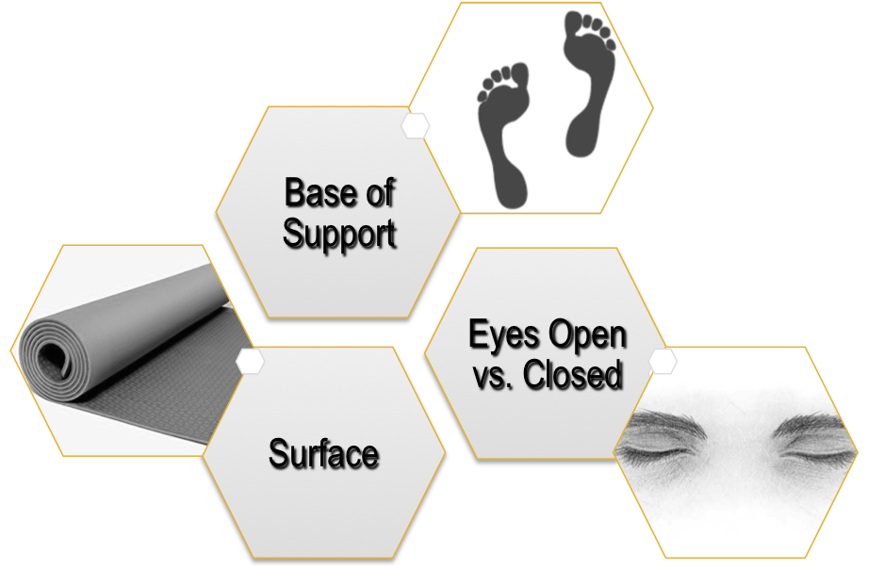
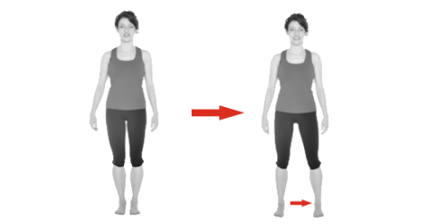
ACTION STEP: Balance Practice
Base of Support
Eyes Open vs. Closed
Surface
Notes:
With this slide I want to provide some ideas for how to design a balance exercise that is specific to your needs and skill level, as well as, teach you how to change the focus of the exercise to bias different parts of your balance system.
Some options are to...
CHANGE YOUR BASE OF SUPPORT. In other words, standing with your feet spread apart vs narrow. This is an overall way to scale the challenge to your skill level.
CHANGE THE SURFACE YOU ARE STANDING ON. Practice on a firm surface (such as tile or hardwood) vs a compliant surface (such as carpet, a folded towel, or a foam pillow) that is squishy under your feet. This reduces the quality of information you can gather proprioceptively.
Lastly, PRACTICE WITH EYES OPEN vs. EYES CLOSED to reduce your visual reliance.
If you combine eyes closed on a compliant surface you are going to call upon your vestibular system to work the hardest!
As you make these changes recognize that you probably only want to change one variable at a time. And have someone there to guard you or provide assistance if needed as you explore these options.
We have talked about how to scale this balance exercise so it is appropriate for you and fits the criteria to promote neuroplastic change! Let's discuss this a bit more...

Slide 18
How To Exercise: BALANCE
High Intensity: effortful and leaves you swaying or wobbling a bit (without being unsafe).
Challenging and Cognitively Engaging
Repetitious
Progressive
Meaningful
Specific
Notes:
Remember, high intensity. We want the balance activity to be effortful such that it has you swaying a bit, without falling all over the place or putting yourself at a risk for falls! If you are steady and firm as a tree you are not demanding positive adaptation from your body.

Slide 19
How To Exercise: BALANCE
High Intensity
Challenging and Cognitively Engaging: requires you to continuously focus your attention on the task.
Repetitious
Progressive
Meaningful
Specific
Notes:
Second, we want this task to require your sustained attention. Again, steady as a tree does not fit this bill.

Slide 20
How To Exercise: BALANCE
High Intensity
Challenging and Cognitively Engaging
Repetitious: multiple times per set, daily or weekly.
Progressive
Meaningful
Specific
Notes:
Repetition. Especially with balance, a skill of use it or lose it, we want to engage in regular and repetitious practice.

Slide 21
How To Exercise: BALANCE
High Intensity
Challenging and Cognitively Engaging
Repetitious
Progressive: once you can consistently hold a position for 30 seconds, move on to the next stage.
Meaningful
Specific
Notes:
Progressive. Once you have mastered Stage #1, move on to Stage #2 OR change an element such as the surface you are standing on or try it with your eyes closed.

Slide 22
How To Exercise: BALANCE
High Intensity
Challenging and Cognitively Engaging
Repetitious
Progressive
Meaningful: before you begin, recognize why you are practicing.
Specific
Notes:
Meaningful. Before you begin, recognize why you are practicing. To reduce falls! To promote neuroplasticity! To continue moving well longer!

Slide 23
How To Exercise: BALANCE
High Intensity
Challenging and Cognitively Engaging
Repetitious
Progressive
Meaningful:
Specific: consider real world scenarios you have had difficulty in and replicate these environments.
Seek assistance for a physical therapist to safely do this.
Notes:
Specific: Consider real world scenarios where you struggle with balance. Is it getting up to go to the bathroom at night when it's dark and your vision is compromised? Is it when you're crossing the grass and your surface is uneven? Is it when you are distracted by a cognitive task or conversation?
As you consider these things I would like to suggest you see a physical therapist to help you safely and specifically meet your goals and address your imbalance!

Slide 24
How To Exercise: BALANCE
DANCE, TAI CHI, YOGA, BOXING!
High Intensity
Challenging and Cognitively Engaging
Repetitious
Progressive
Meaningful: before you begin, recognize why you are practicing.
Specific
Notes:
Also, don’t forget the fun and integrated ways to practice your balance! Dance! Tai Chi! Yoga! Rock Steady Boxing!

Slide 25
Strength
GOAL: improve muscle performance
Power
Endurance
Force Production
Notes:
Breathe in, breathe out.
Are we ready for the next Action Step?
STRENGTH.
The goal of a strength or resistance exercise is to improve muscle performance. There are 3 main things that make for good muscle performance. Those are POWER (the speed of which you can turn your muscles on – think of the quick spurt you need to stand from a chair or the quick step you need to recover your balance if you start to tip), ENDURANCE (how long you can continously use your muscles – think about walking to your grandkids birthday party in the park vs just getting across the living room to the bathroom), and FORCE PRODUCTION (the amount of oomph you can get from your muscles).
We know that Parkinson's can lead to bradykinetic or hypokinetic movements. These mean low oomph and slow speed movements. We want to counter these tendencies by choosing to engage in strength exercises with maximal EFFORT! Don't let your body and brain create weak and small movements. If we continue to live in slow and small movements we can actually see a conversion of muscle fiber type from fast twitch to slow twitch fibers. Just as it sounds, you can become anatomically and physiologically disadvantaged to create effective and quick movements in your daily life.

Slide 26
ACTION STEP:
Sit to Stands (or Squats)
Notes:
To further explore this element of exercise we are going to use a sit to stand or squat activity.

Slide 27
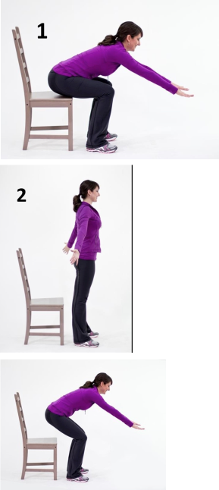
ACTION STEP:
Sit to Stands
(or Squats)
When you get to the top stand in open and upright posture!
Notes:
The key to a good stand is your ability to shift your weight forward over your feet. Remember when we talked about maintaining your body weight over your base of support during the balance task? In this activity, if you do not move your body weight over your feet then when you attempt to stand you are going to fall backward! Or feel like gravity is glueing you to the chair. So get your body and bum forward and your feet underneath you. This woman does a wonderful job of demonstrating it. Once you are well set up stand up with POWER! As described previously, think about doing this task with MAXIMAL effort. Don't let your body practice with 50% go power, turn on those jets! Promote strength and fast twitch fibers!

Slide 28
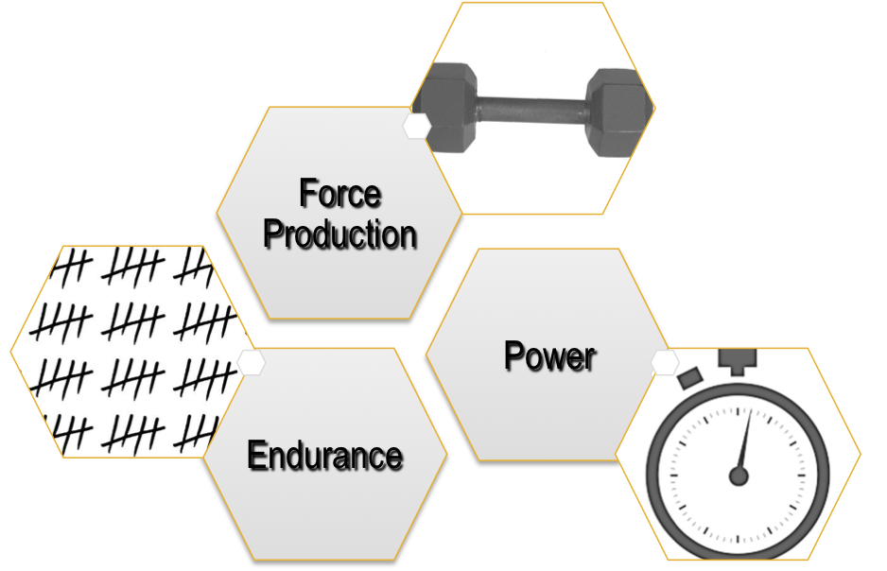
ACTION STEP:
Sit to Stands
(or Squats)
Height of Chair
Speed of Performance
Number of Repetitions (without rest)
Notes:
Considering the task of a sit to stand there are several ways to modify this activity to highlight the different aspects of muscle performance.
First, we can...
CHANGE THE HEIGHT of the surface to increase force production demands.
COMPLETE AS MANY REPS as you can in a set amount of time to promote speed and power.
ENGAGE IN SUSTAINED/CONTINUOUS practice with limited rest time to promote muscle endurance.
Remember, we want progressive loading! So play with these elements to continue to challenge your body. Studies have shown that progressive resistance training leads to reduce motor signs in PD at 2 yr follow up.

Slide 29
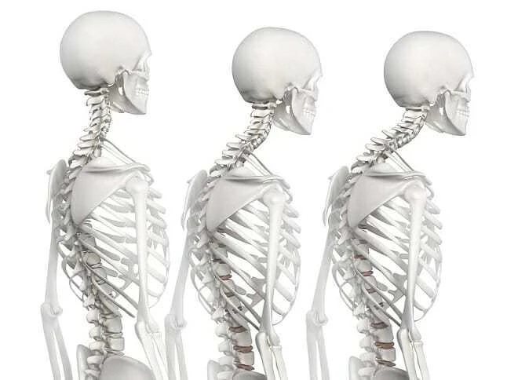
Stretching & Posture
GOAL: reduce rigidity and improve flexibility to optimize efficiency and ease of movement.
Flexibility
Rotation
Postural Strength
Notes:
Ok, third exercise category.
STRETCHING & POSTURE
The goal of exercises in this category are to promote flexibility, reduce rigidity, and optimize strength to maintain functional and strong posture.
We want to promote FLEXIBILITY of muscles to reduce forward head and flexed posture. We want to utilize ROTATION to reduce axial rigidity which can lead to pain and what we call enbloc or stiff trunk movements. And we want to be intentional about STRENGTHEN extensor muscles to keep your posture upright and strong.

Slide 30
ACTION STEP:
Stretching & Posture
Notes:
This is going to be an information packed Action Step!

Slide 31
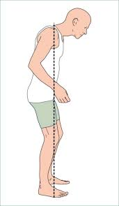
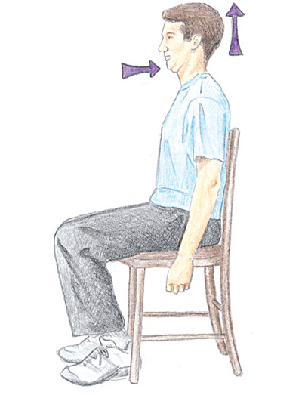
ACTION STEP:
Postural Checks
Have someone take a picture or film your posture.
Can you improve it?
Notes:
The first step I usually like to have people do is observe their own posture. Remember, with PD your body may not be giving you adequate internal cues about your body. So, external cues or new ways to provide feedback to your brain are a good thing! A great way to do this is to have a friend of family member take a picture of your posture when you aren't paying attention and then when you are. Can you pull yourself out of that forward flexed tendency? Can you bring your head up over your shoulders? Can you pinch your shoulder blades together to promote strong posture?
https://www.mountnittany.org/articles/healthsheets/3530
31

Slide 32
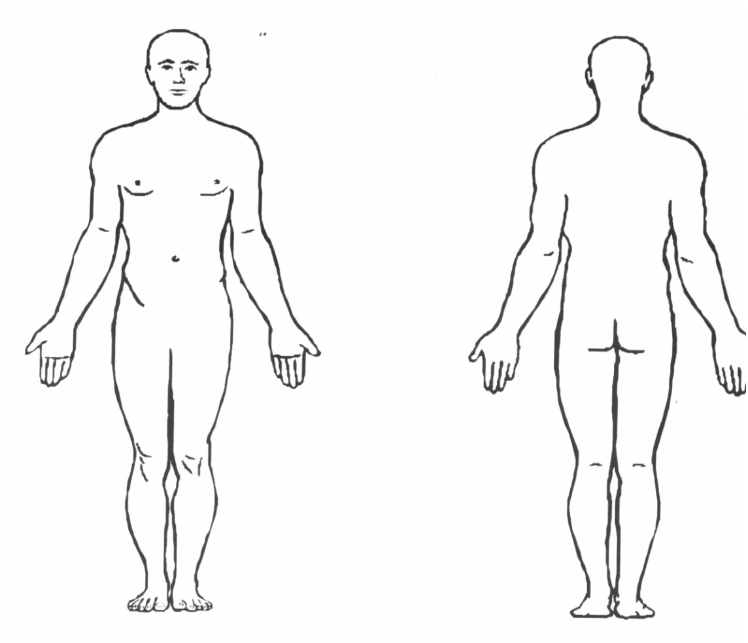
ACTION STEP:
Flexibility
STRETCH
Chest
Back of Knees
Front of Hips
Calves
Notes:
As I mentioned we often see a tendency toward forward flexed posture. Allowing this postural habit to perpetuate can result in pain and stiffness, poor movement, and increased risk for falls. To maintain flexibility and optimal posture we want to STRETCH tight muscles. These muscle groups are listed above and we will highlight some possible stretching ideas in the following two slides. Stretches should be gentle but adequate and held 1-2 minutes if tolerated.
A stretching routine can be a great way to start your day! Wake up mindfully and start your day moving well.
32

Slide 33
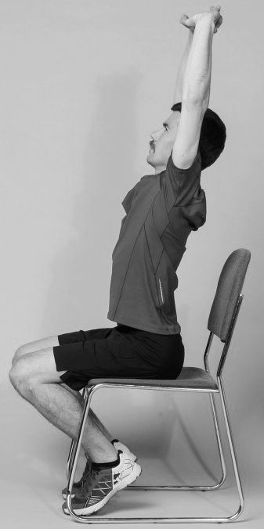
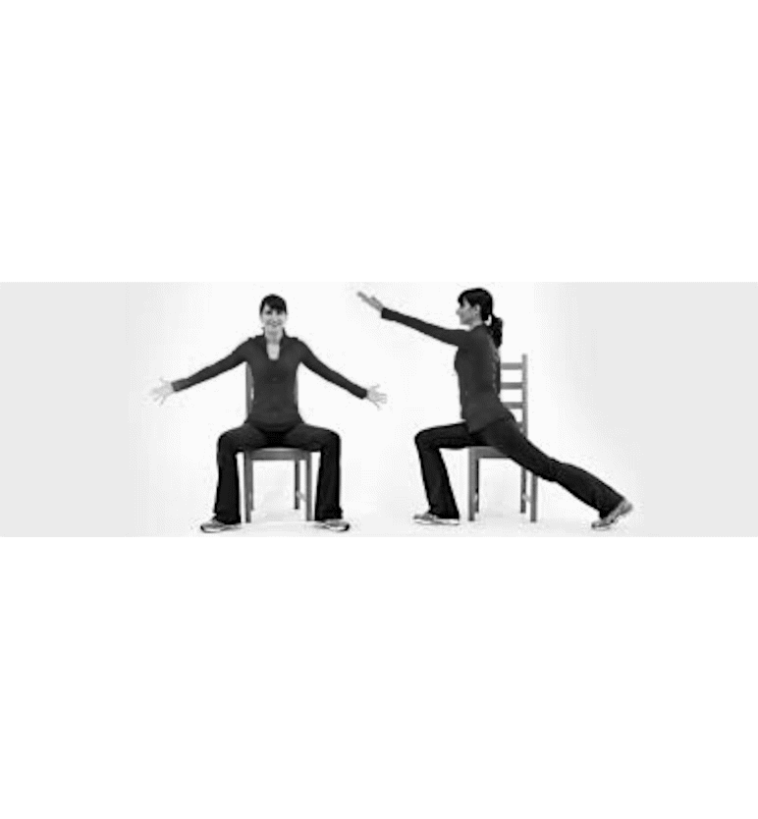
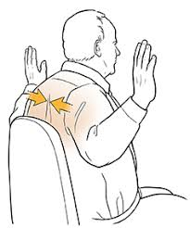
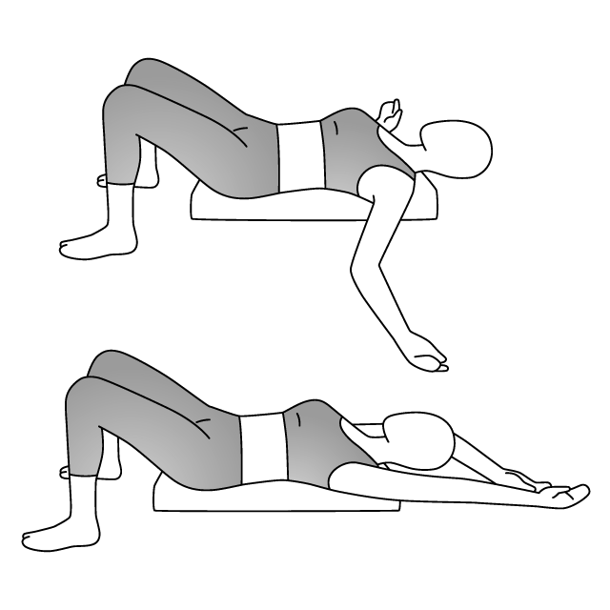
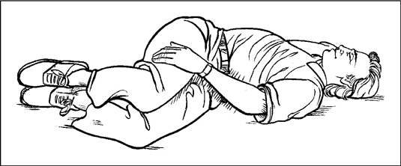
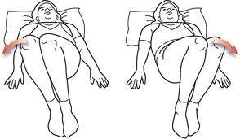
Stretch Felt Here
ACTION STEP:
Flexibility & Rotation
Stretch Felt Here
Stretch Felt Here
Notes:
You will see here strategies for upper body stretching and rotational activites. Think about opening up through your chest and reaching your body out long. There are some great guided stretching videos on YouTube or Davis Phinney supported sites. Make sure you check out their webpage for additional ideas.
PWR! Breathe Cycle: https://www.youtube.com/watch?v=POiAkJeFSRs
33

Slide 34
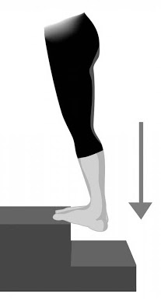
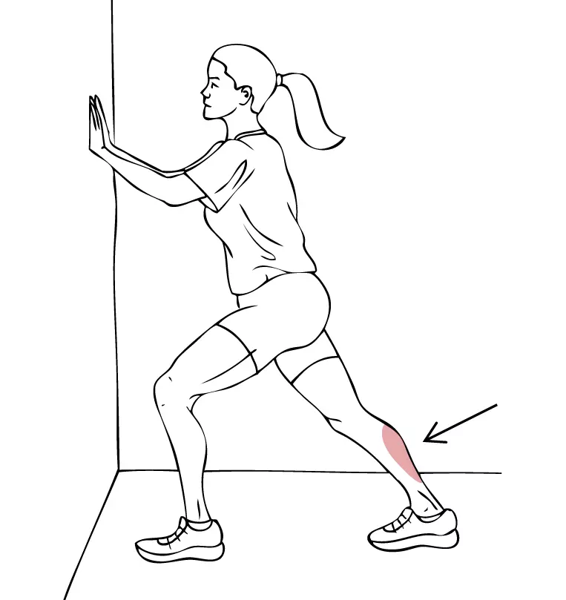
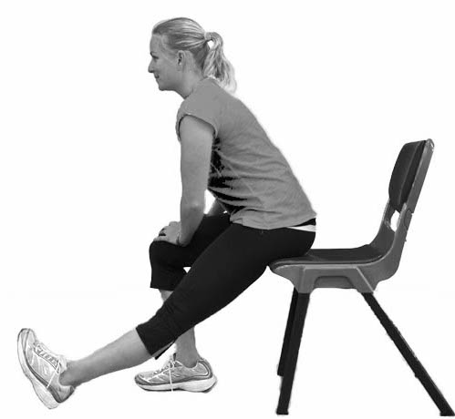
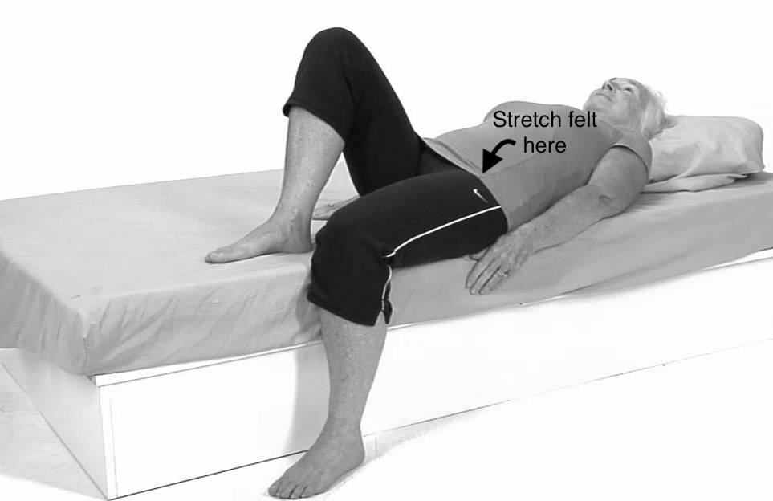
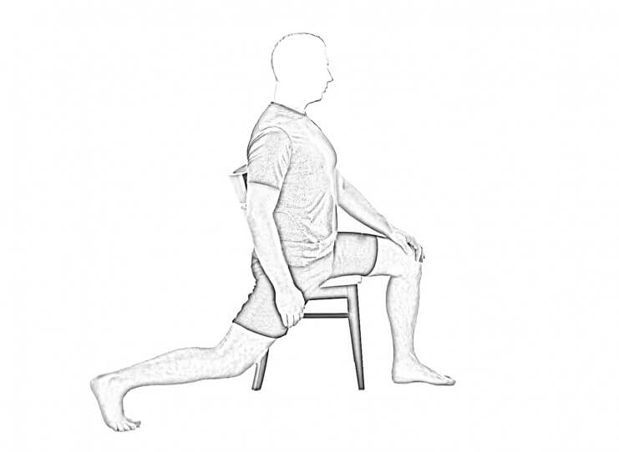
ACTION STEP:
Flexibility
Stretch Felt Here
Stretch Felt Here
Notes:
This slide highlights lower body stretching. Remember, flexibility in the front of hips and back of thighs are keys to being able to stand up tall!
34

Slide 35
ACTION STEP:
Postural
Strength
STRENGTHEN
Upper Back (and Low Back)
Core
Hips/Buttock
Quads
Notes:
Here I touch on where we want to focus our attention for STRENGTHENING muscles that will allow us to maintain the beautiful postural abilities we just gained from stretching. Flexibilty gets us the potenetial for optimal posture, strengthening keeps us there! A physical therapist or movement specialist should be able to help you identify and practice strength exercises to target these muscle groups! You can even take this slide into your provider OR consider a PD specific exercise class because these muscle grounps are often targeted.
CORE: collection of muscles that move, support, and stabilize your spine (front core, pelvic floor, diaphragm, and back extensors)
Uses: rolling in bed, balancing, standing up from a chair, taking a step, reaching for something, lifting or carrying
https://pubmed.ncbi.nlm.nih.gov/23536417/: progressive resitance training leads to reduce motor signs (at 2 yr follow up)
35

Slide 36
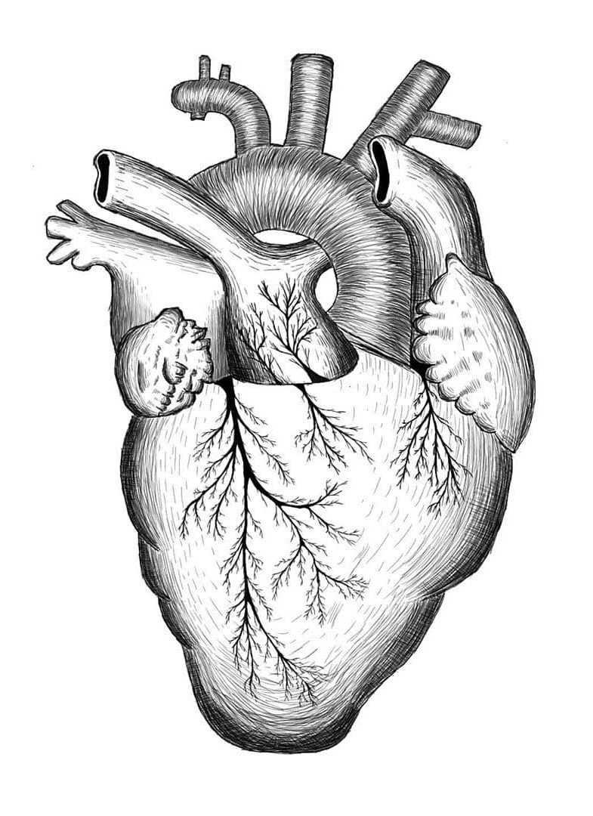
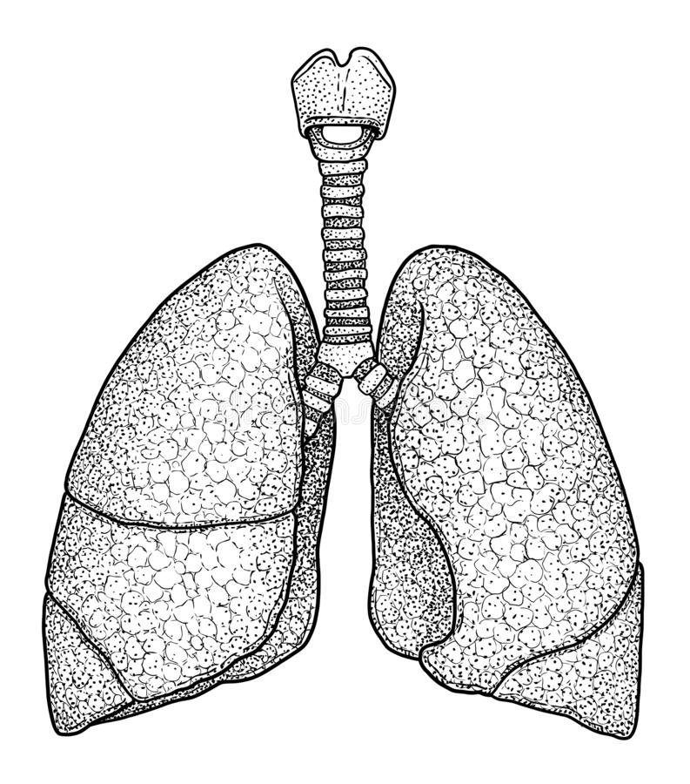
Aerobic Exercise
GOAL: improve cardiorespiratory health, promote endurance, and gain neuroprotective benefit.
Moderate Intensity
150 Minutes Per week
Notes:
Now we will talk about AEROBIC EXERCISE. This is fancy lingo for getting your heart rate up.
The goal of aerobic exercise is to improve your cardio (heart) and respiratory (lung) health and gain neuroprotective benefit. Aerobic exercise is one of the keys to neuroprotection and slowing the disease! The parameters that have been highlighted to achieve these goals are to engage in moderate to high intensity effort for a TOTAL of 150 minutes per week. You don't have to worry about being exact down to the minute, but do the best you can!
Aerobic exercise increases blood flow and changes the brain environment, which may actually help improve neuroplasticity and motor learning. Changes brain and synaptic health.

Slide 37
ACTION STEP:
Aerobic Exercise
Notes:
Let's talk a bit more about how to achieve these goals.

Slide 38
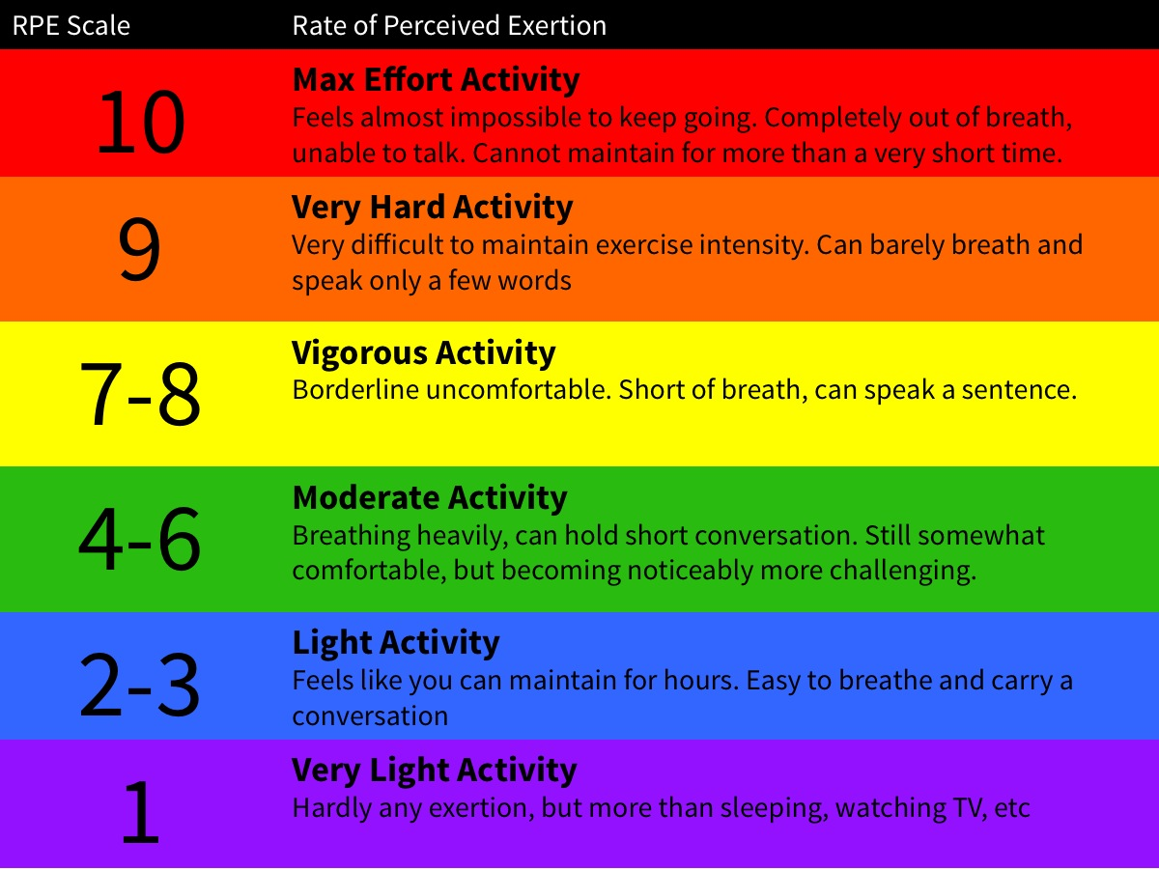
ACTION STEP: Aerobic Exercise
Get your heart rate up!
Monitor your effort using this scale
Seek medical or exercise specialist guidance.
Notes:
A great way to monitor your effort level is to use what we call the Modified BORG Scale or Rate of Perceived Exertion. This has been well docmented as a correlate with your heart rate, a commonly used metric of activity intensity. The target range is RPE 6-7 out of 10 (as noted with the arrow on this slide). You will see that this means breathing heavily but still being able to hold a short conversation or speak one sentence at a time. You should feel like you are working!
If you have any underlying cardiac or lung conditions please consult closing with your physician or a physical therapist!
38

Slide 39
ACTION STEP: Aerobic Exercise
Dancing
Yoga / Chair Yoga
Walking
Boxing
Hiking
Cycling
Treadmill
Aquatics
Cross Country Skiing
PD Specific Exercise Groups
Notes:
So how to we get those 150 minutes in?
If it were me, 150 minutes on a treadmill would be a dreadful sentence. Haha! But that's not what I'm asking you to do, don't worry!
Remember you don't have to be exact, but you want to get as close to totaling 150 minutes in a week as you can. This could be 2 x 10 min per day for 7 days per week OR 30 minutes per day 5 days per week OR 3 x 1 hour group exercise classes per week. I have also listed some other fun ways to engage in aerobic exercise. One useful tool can be tapping into with this is the success/positive reward loop in your brain, which helps increases dopamine release! That means make it fun! Enjoy yourself! Try something new! Do it with friends or a loved one! Work out to motivating music!
Walk: hiking poles, treadmill, outside, continuous laps in your house
Bike: outdoors, NuStep, indoor cycling (low impact option)
Swim/Water Aerobics (low impact option)
...Or if your sit to stands get your heart rate up, they count!
39

Slide 40
Dual Task
GOAL: improve tolerance to complex environments that require you to distribute your attention between multiple tasks.
Cognitive (think)
Motor (do)
Auditory (listen)
Visual (identify)
Notes:
So now we're going to shift gears just a little bit. We are going to talk about something called Dual Task or Split Attention. Many people believe we multitask, meaning we do tasks simultaneously but what we are learning is that at a brain level we are actually quickling switching our attention between those simultaneous performances. One thing we can see happen in people with Parkinson's is a slowing down this switching ability. The good news is that practicing this skill can help with dual task ability. So the goal of a dual task environment is to increase your tolerance to complex environments and safe mobility. Several real world examples of dual task are keeping your grocery list in your memory while you walk down the grocery aisle, talking to a friend or spouse while you walk, carrying a mug of coffee or cup of water from the kitchen to the living room... There are 4 categories of dual task. These cognitive, motor, auditory, and visual.

Slide 41
Fall Risk Predictor Test
Walking While Talking Test
Do you have to stop walking to talk?
Could you recite alternating letters of the alphabet without slowing down?
Notes:
A great way to test your dual task ability is to consider a test called the Walking While Talking Test. This test has you walk at your selected pace. Then walk again while talking. Then walk again while reciting alternating letters of the alphabet out loud. You can likely anticipate how you will perform. If you slow down or lose your balance in the scenarios where you are simultaneously completing a cognitive task then it may indicate you would benefit from focused dual task practice.

Slide 42
ACTION STEP:
Dual Task

Slide 43
ACTION STEP: Dual Task - practice
*Recognize that complex or distracting environments can be correlated with movement
breakdown, impairments in walking, or fall risk. So be careful!
Add a simultaneous task to any activity.
Recite the alphabet backwards
Recite words that start with the letter "D"
Turn your head right to left
Sing along with a song
Count backwards by 3s
Move coins from your left to your right pocket
Notes:
Dual Task can be practiced in the context of the previous 4 categories of movement we have highlighted in the session. I want to make a quick recommendation that you be careful when considering this type of training. Complex or distracting environments can be correlated with movement breakdown, impairments in walking, or fall risk.
43

Slide 44
ACTION STEP: Dual Task - compensation
Reduce Distractions
Use an Assistive Device
Use visual or auditory cues to re-initiate or improve movement.
Count steps to turn
Got stuck? Count out loud to 3 and take a large step
Step to a metronome or tune
Step over/to a target
Notes:
For those who already struggle in complex or distracting environments then I recommend you instead work closely with a physical therapist and you consider using the strategies highlighted on this slide when engaging in the "real world" to optimize your safety, preserve your movement, and reduce your risk for falls, freezing, or festination.
44

Slide 45
Track Your Progress &
Stick With It!
This is a marathon, not a sprint.
Notes:
Here I will highlight some tools for staying engaged and motivated.

Slide 46
Track Your Performance
Within a Session:
Time
Number of repetitions
Task intensity (ex. bike resistance or treadmill speed)
Between Sessions:
Make a chart
Use of phone app
Get an accountability partner
Notes:
We can track our progress between sessions and over the course of weeks or months to recognize the improvements we make when we are regularly engaged in exercise!

Slide 47
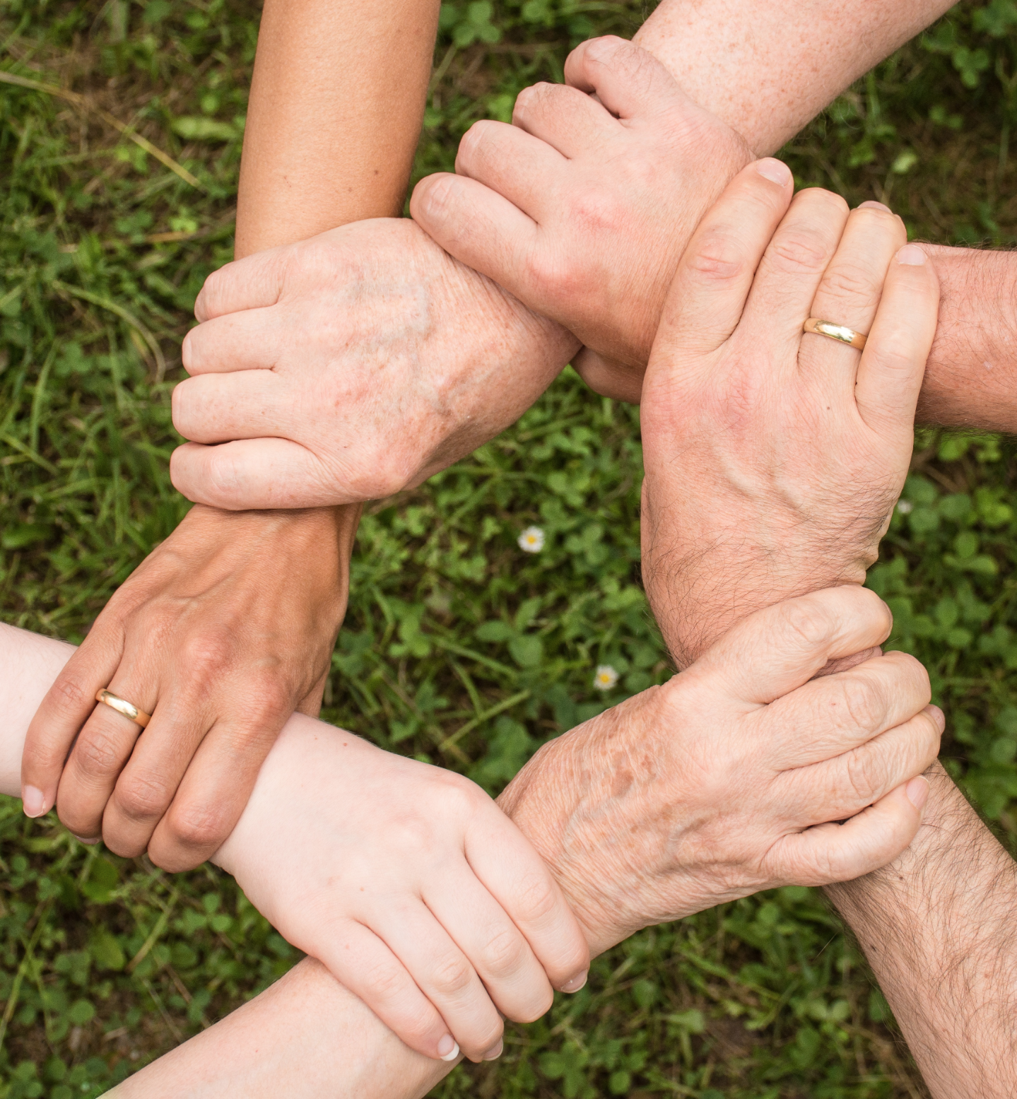
Find Support:
Family
Friend
Caregiver
Support Group
Exercise Class
Physical Therapist
Occupational Therapist
Neurologist
Personal Trainer
Notes:
I also commend you to have a support system. Build a team, a tribe around you that will keep encouraging and supporting your to reach your goals.
47

Slide 48
Find Support:
Family
Friend
Caregiver
Support Group
Exercise Class
Physical Therapist
Occupational Therapist
Neurologist
Personal Trainer
THIS IS A MARATHON, NOT A SPRINT.
Notes:
Remember, this is a marathon not a sprint. Anyone who has trained for or participated in a long race knows it takes a team around you in order to be successful. The athlete, THAT'S YOU, needs support to win the race!
48

Slide 49
ACTION STEP:
See a Parkinson's Physical Therapist
Notes:
My final call to ACTION is for you to identify and work directly with a Parkinson's Physical Therapist. Being proactive and specific with your training can keep you moving well longer!

Slide 50
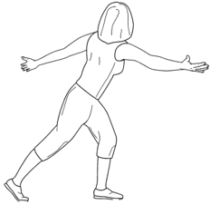
ACTION STEP:
See a Parkinson's Physical Therapist
Fitness classes and home workouts are wonderful ways to move your body, but do not negate the value of working with a physical therapist specialized in helping you combat motor decline and optimize your function in every stage of the disease.
Notes:
Challenges and fluctuations in your symptoms during the disease progression are normal. It can be helpful to have a PT help you navigate these challenges. Especially during these times where access to group classes, support networks, and gyms are low reaching out to a PT could be a critical step.
50

Slide 51
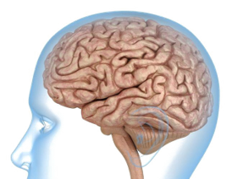
ACTION STEP:
See a Parkinson's Physical Therapist
Patient Specific Intervention and Programming
Pain
Dual Task Training
Caregiver Education & Training
Problem Solve Daily Activities
Equipment Acquisition
Notes:
What specifcally can a PT do for you?
They can provide focused stretching and strengthening programming for YOUR body taking into consideration your Parkinson's subtype, comorbidities, orthopedic injuries, etc.
Help address your pain so you can get back to living and moving.
Dual task specific to your environment or symptoms. And provide a safe place to push your level or skill and balance.
Caregiver education and training to help you work better as a team.
Help problem solve movement in your home environment and teach you strategies to more easily complete your daily tasks such as getting in/out of the car, walking through busy environments, or moving around in bed.
Appropriate and timely assistive device acquisition or home modification tools.
And lastly they can help you set realistic goals and achieve them! If that is walking better or running a 5K.
...and as with any marathon, a PT can be on your support staff to for the entirety of your race. Build relationship and connection so they are there to assist you when you need them the most.
51

Slide 52
Review
What did we just learn?

Slide 53
Exercise is beneficial for the management of both motor and non-motor PD symptoms.
Exercise improves the effectiveness of your medications.
Exercise is neuroprotective.
Exercise should be cognitively engaging, high intensity, repetitious, progressive, meaningful, and specific.
Set measurable goals and track your progress.
Find your support system.
And most importantly find a way to move that you ENJOY!

Slide 54
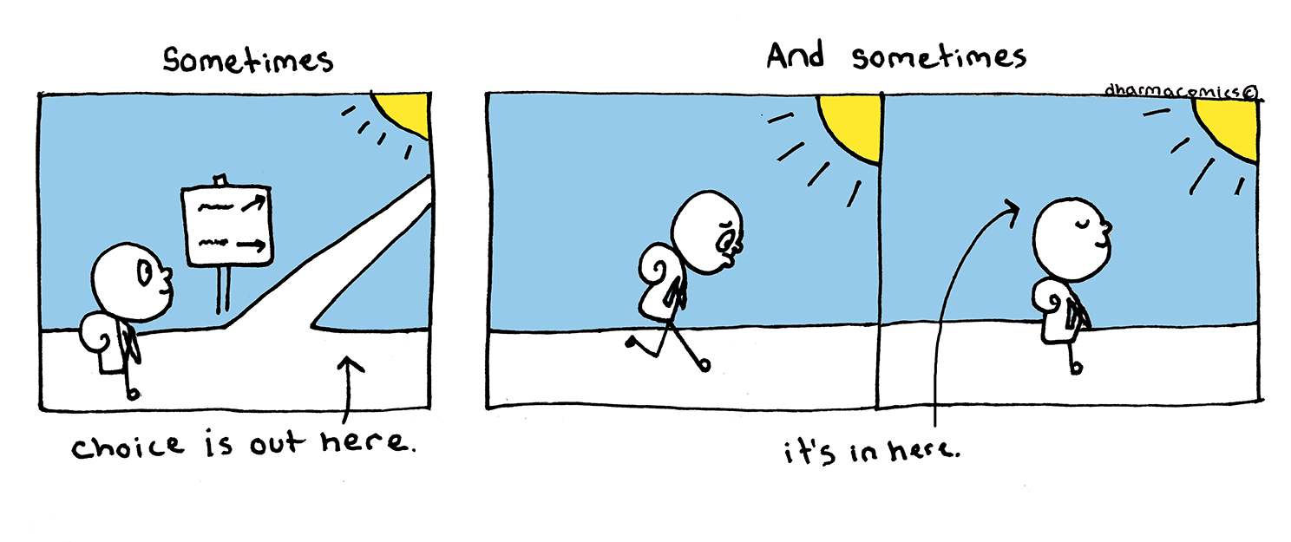

Slide 55
The End

